Slide 1

Annual Housing Community Meeting
Housing Element Status Update
October 10, 2024
Notes:
Good evening Chair Keldorf, fellow Commissioners and members of the public. Thank you for your time and for participating in this 2nd annual housing community meeting.
As you may know, in 2022, the City Council adopted the current Housing Element, which is the City’s 8-year plan for addressing its housing needs. One of the major Housing Element goals is to communicate with residents about this plan, report on our progress, and receive input on how well we are doing and what we should be focusing on. This meeting is part of our ongoing outreach program, which I will touch on a little later in the presentation. But first I would like to cover some housing element basics …

Slide 2
What is the Housing Element?
One of seven mandated elements of the General Plan
Must be updated every 8 years
Certified by Department of Housing and Community Development (HCD)
Contents:
“Community Profile”
Provides an assessment of both current and future housing needs
Demographics – Population, Households, Special Needs Groups, Housing Stock
“Housing Constraints”
Identifies constraints – Governmental and Non-Governmental
“Housing Resources”
Identifies “housing sites” that can accommodate City’s RHNA
“Housing Plan”
Provides a comprehensive strategy that establishes goals, policies, and “programs”
Notes:
The Housing Element is part of the City’s General Plan which has 9 other Elements, (Land Use, Circulation, Housing, Conservation, Open Space, Noise, and Safety, (ES extra: Economic Development, Air Quality, Hazardous Materials & Waste))
The State of California requires every City to update its Housing Element every 8 years and it sets strict parameters and obligations on Cities.
These are the main contents of the H Element.
Community Profile: provides demographic information and assesses the City’s current and future housing needs.
Constraints to housing production: Those constraints can be Govt: regulations. Non govt: available land, market supply, etc.
Resources section and
Housing Plan
This presentation will focus more on the resources and plan, meaning the goals and our programs/policies to meet those goals. Starting with …

Slide 3
Regional Housing Needs Allocation (RHNA) for 2021-2029
Income Category | 5th Cycle Carryover | 6th Cycle RHNA | Total RHNA | Percent
Extremely/Very Low Income | 18 | 189 | 207 | 39.7%
Low Income | 11 | 88 | 99 | 19.0%
Moderate Income | 0 | 84 | 84 | 16.1%
Above Moderate Income | 0 | 131 | 131 | 25.1%
Total | 29 | 492 | 521 | 100.0%
Notes:
… starting with facilitating the production of a minimum number of housing units, including units affordable to lower income households . (As I mentioned) Every 8 years the State assesses the need for housing statewide and allocates that need among various regions and municipalities, and this table shows the State allocation for El Segundo.
For the 8-year period from 2021 to 2029, the City needs to incentivize and/or require developers to provide 521 new units, including 390 below market rate.

Slide 4
Housing Solutions
Accessory Dwelling Units (ADU)
Entitled Projects
Sites Inventory/Rezoning
Notes:
The Housing Element anticipates that the goal will be met in three ways. (ADU, Entitled projects, site inventory) GO NEXT SLIDE
Provide ADU data to-date.
2021 – 31 applications, 19 issued
2022 – 44 applications, 33 issued
2023 – 31 applications, 18 issued
2024 – 27 applications, 14 issued

Slide 5
Housing Solutions
Accessory Dwelling Units (ADU)
Entitled Projects
Sites Inventory/Rezoning
2021-2029 – 120 projected
2021 – 19 permits issued
2022 – 34 permits issued
2023 – 18 permits issued
2024 – 14 permits issued
Total – 85 permits issued
Notes:
The Housing Element projects that approximately 120 ADUs will be permitted during the 8-year planning period or 15 ADUs per year
ADU data to-date. So far,
2021 – 31 applications, 19 issued
2022 – 51 applications, 34 issued
2023 – 29 applications, 18 issued
2024 – 27 applications, 14 issued (to end of Sept)
There is a trend and anticipated to continue and will produce portion of the allocation, including some affordable units.
85 issued or 21 per year.

Slide 6
Housing Solutions
Accessory Dwelling Units (ADU)
Approved Projects
Sites Inventory/Rezoning
Pacific Coast Commons
263 units
(32 affordable)
Notes:
Approved or entitled projects. Before the City Council adopted the Housing Element in 2022, the City had approved the Pacific Coast Commons project.
That project includes 263 multi-family units 32 of which reserved for households with lower incomes.
The developer has not applied for construction permits yet, but we anticipate that they will during the 8-year period.
(3-year construction process)
When constructed, this project will reduce the RHNA requirement for affordable units from 390 to 358. (market rate from 131 to 0)

Slide 7
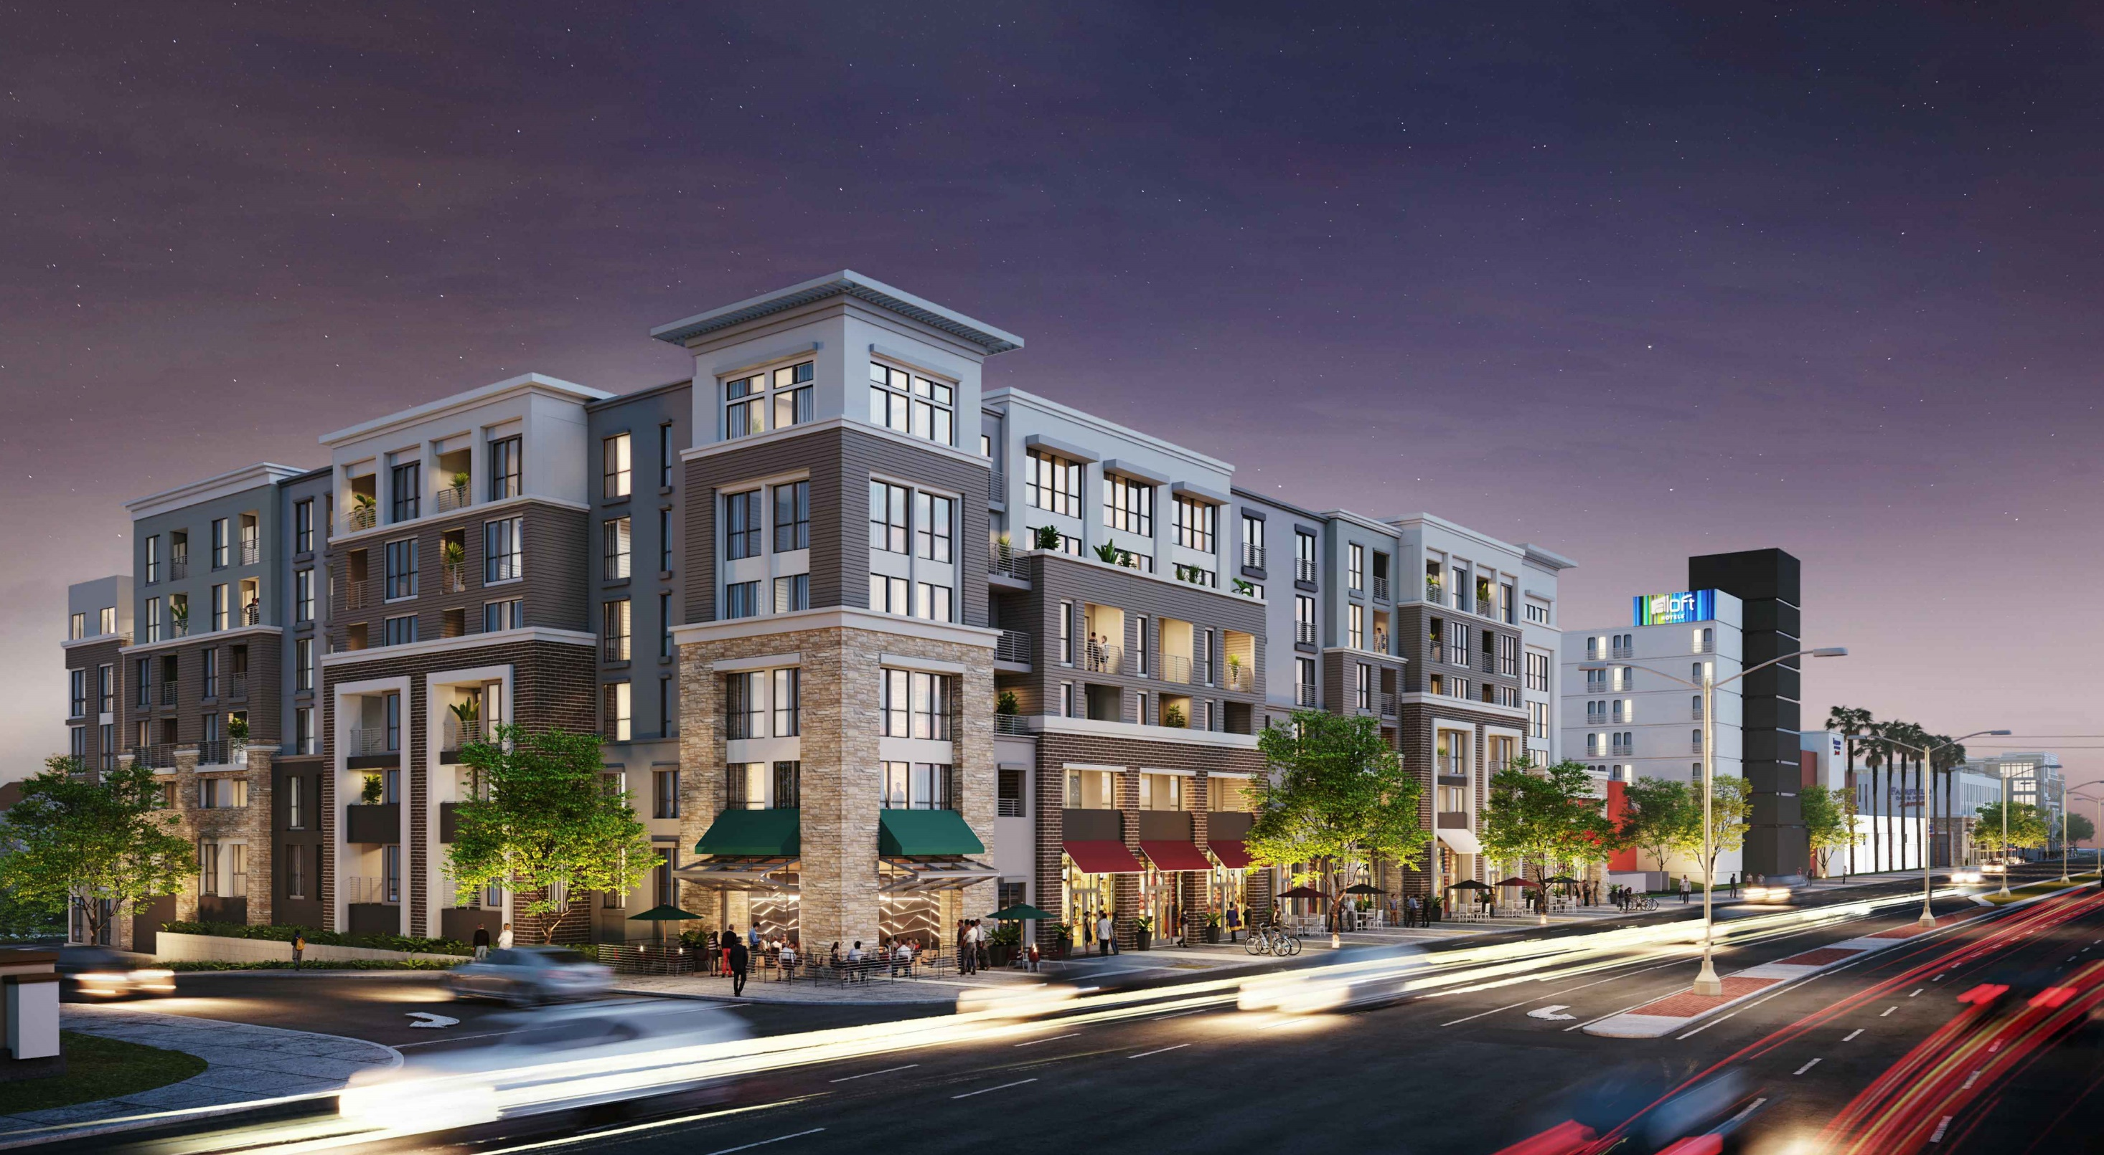
Pacific Coast Commons
Notes:
Approved or entitled projects. Before the City Council adopted the Housing Element in 2022, the City had approved the Pacific Coast Commons project.
That project includes 263 multi-family units 32 of which reserved for households with lower incomes.
The developer has not applied for construction permits yet, but we anticipate that they will during the 8-year period.
(3-year construction process)
When constructed, this project will reduce the RHNA requirement for affordable units from 390 to 358. (market rate from 131 to 0)

Slide 8
Housing Solutions
Accessory Dwelling Units (ADU)
Approved Projects
Sites Inventory/Rezoning
Notes:
The sites inventory contains a list of properties where construction is anticipated to occur, including properties rezoned to permit high density residential development.

Slide 9
Sites Inventory – Rezoning program
COMPLETED!
Notes:
The Housing Element program No. 6 calls for rezoning certain areas to allow for high density residential developments.
In May (7, 2024), of this year the City Council established two zoning overlays. the first is a mixed-use overlay that consists of non-residential properties, primarily along PCH (Pacific Coast Highway) that will permit mixed-use developments (ground floor commercial and residential on the upper floors). Nine sites (9).

Slide 10
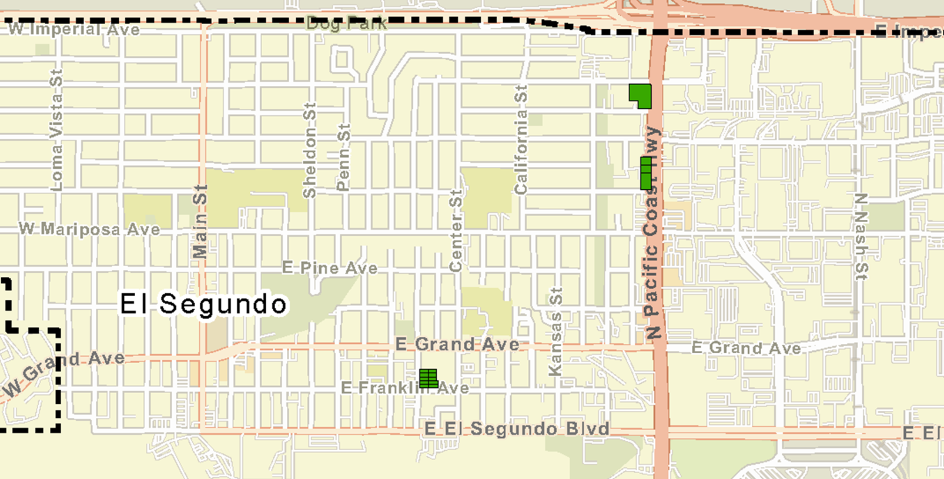
Program No. 6 - Rezoning (Mixed-Use Overlay)
Four sites
Density: 75 du/ac
Additional units: 335
Mixed-Use Overlay
Notes:
The MU-Overlay involves four sites, three along PCH and one in Smoky Hollow (the property known as Wyle park) at Maryland and Franklin (CO, C-3, and Parking zones)
The permitted density in this Overlay is 75 du/ac which has the potential to generate over 300 (up to 335) new units.
[58-foot height limit (4 stories)]
CLICK:
We have an active application to develop one of these sites:
At 703 North PCH (the old Stick n Stein property)
CLICK NEXT (– 79 units, 4 VL)

Slide 11
703 North PCH
Notes:
This is a rendering of what the proposed development would look like. Keep in mind, that the plans have not been finalized, as we are still in the review process.
This project currently proposes 79 units, including some affordable, and it makes use of the State Density Bonus Law to obtain waivers from certain development standards.
This project is subject to a site plan review application. So, it will come before the Planning Commission, but the Density Bonus and concessions are not subject to PC review. (Only the Site Plan Review, and as you may recall the findings were simplified in a recent ZTA to streamline approvals. )
The key point here is that our rezoning efforts and code amendments are bearing fruit. The market is interested in developing housing, which in turn will help the City meet its housing construction goals.

Slide 12
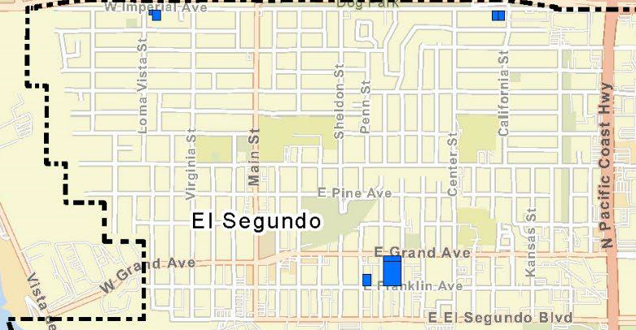
Program No. 6 - Rezoning (Housing Overlay)
Five sites
Density: 65 du/ac
Additional units: 193
Housing Overlay
(Phase 1)
Notes:
The second overlay is the Housing Overlay, which includes five R-3 zoned properties. The density for this overlay is 65 du/ac, which is anticipated to generate about 200 more residential units.
[47-foot height limit (3 stories)]
These five sites in combination with the MU-O sites and HE other programs are sufficient to meet our minimum RHNA allocation.

Slide 13
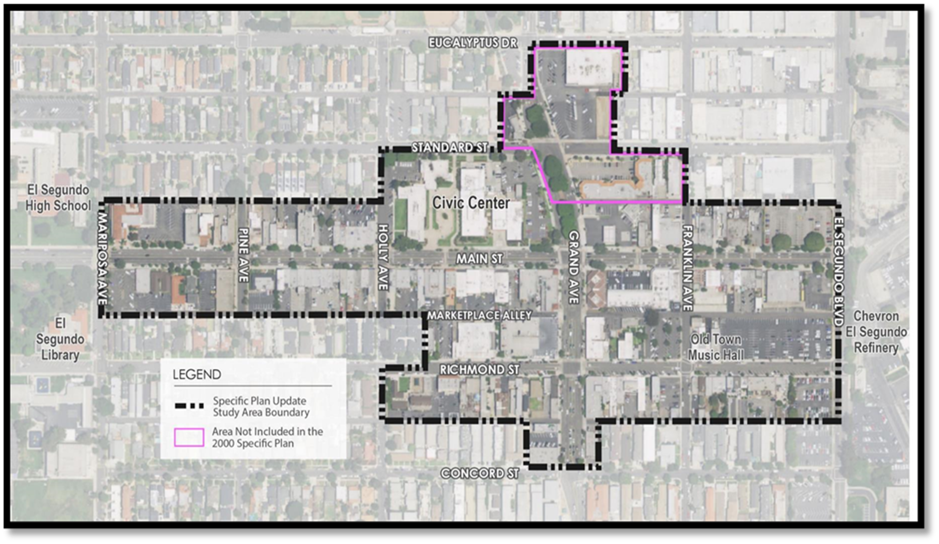
Program No. 6 - Rezoning (Downtown Specific Plan)
District-wide
Density: No maximum
Additional units: 300
Housing Overlay
(Phase 1)
Notes:
Part of Program No. 6, was a comprehensive update of the Downtown Specific Plan, which was completed in May 2024. The update expanded the Specific Plan and lifted the maximum density district-wide and relaxed several other standards, which will incentivize construction of up to 300 units during the life of the SP.

Slide 14
Housing Programs
Residential Sound Insulation (RSI)
Code Compliance Inspection Program
Accessory Dwelling Units (ADU)
Inclusionary Housing Ordinance and Affordable Housing Strategy
Urban Lot Split
Provision of Adequate Sites
Monitoring of No Net Loss
Lot Consolidation
El Segundo Municipal Code Amendments
Community Outreach
Fair Housing
Notes:
That was a quick summary on the number of units and the areas where we expect the new units to be constructed.
The housing element contains 11 programs to help encourage and/or facilitate construction of new housing in the above areas. I will touch briefly on most of the programs next
NEXT slide: Programs 1 and 2 are about conserving and improving existing affordable housing

Slide 15
Housing Programs/Plan
Residential Sound Insulation (RSI)
Code Compliance Inspection Program
Accessory Dwelling Units (ADU)
Inclusionary Housing Ordinance and Affordable Housing Strategy
Urban Lot Split
Provision of Adequate Sites
Monitoring of No Net Loss
Lot Consolidation
El Segundo Municipal Code Amendments
Community Outreach
Fair Housing
Notes:
Programs 1 and 2 are about conserving and improving existing affordable housing.
The RSI program funds sound insulation improvements and is administered directly by LAWA (City of LA). However, all improvements go through the City’s permit process.
LAWA is kicked off the first 60 or so homes early 2024 (February – May), with anywhere between 60-100 homes every quarter thereafter, for the next 5 years.
So far in 2024 we have received 82 permit applications.
Our Code compliance program (officially called Neighborhood Preservation) operates under the Community Development Dept. It has one fully time employee, but a 2nd part time employee is expected to be hired around the end of 2024. Activity has increased in the last couple of years and this year so far (up to September) we have had (134 commercial and) 148 residential cases (zoning violations, vegetation, housing concern, work w/o permits). This is an increase compared to all of 2023 when we had 112 residential inspections and 2022, when we had 87 residential violations/inspections. With the addition of a 2nd Neighborhood Pres Officer, will likely continue to increase.

Slide 16
Housing Programs/Plan
Residential Sound Insulation (RSI)
Code Compliance Inspection Program
Accessory Dwelling Units (ADU)
Inclusionary Housing Ordinance and Affordable Housing Strategy
Urban Lot Split
Provision of Adequate Sites
Monitoring of No Net Loss
Lot Consolidation
El Segundo Municipal Code Amendments
Community Outreach
Fair Housing
Notes:
The above highlighted programs involve facilitating construction of new housing by removing barriers and adding incentives in the City’s regulations. For example, Accessory Dwelling Units. The State has placed a great emphasis on relaxing local regulations and promoting ADU construction. In response,
in 2018, we amended the Municipal Code to make it easier to apply for and get ADU permits. In 2023, we further updated our ADU regulations to make them consistent with State Law and clarify certain provisions (density, review timeframes/process, etc.).
I just started going through the recent state legislation and there is at least one law that will affect ADU regulations. So, in the next few months by early 2025 we will bringing a new set of amendments to PC and Council for consideration.
ADUs. As a result of these amendments, there has been an increase in ADU activity since 2018 and we are on track to meet out Housing Element goal of 120 units by 2029
Pr. 5. Urban Lot Split. In 2022 (March), the City amended the Municipal Code to establish standards (consistent with SB 9) for the subdivision of R-1 properties. This will allow, individual lots in the R-1 zone to be divided into two lots and be developed with two units on each. The ordinance also makes progress toward affordability goals by requiring one unit on each lot to be affordable for moderate and lower income households. (We don’t have any applications yet)
Provision of adequate Sites. This is the rezoning program that I described earlier that identifies locations and rezones to allow higher density residential development.
Program 9: ESMC Amendments involves removing govt constraints through code amendments:
Seven completed in 2023
(Density Bonus, Transitional and Supportive Housing, Micro Units May 2023)
(Residential Care Facilities, Emergency Shelters, Low Barrier Navigation Center (LBNC), Employee Housing, Reasonable Accommodations, Senior Housing December 2023),
- Three completed in 2024 Part of the rezoning package R-3 zone density (27 to 30 du/ac), Site Plan Review Findings, [10-lot subdivisions (extra)]
One to do in EARLY 2025:
Parking standards (recent study session with PC)
Several code amendments completed 11/12 and one in progress, to be completed this year and early 2025.
Many of these changes are required by State Law.
DSP update will provide more housing opportunities. Completed (EA 1311) May 2024
A quick word about the Affordable Housing Strategy. The City Council adopted the Affordable Housing Strategy on Dec. 14. Codify El Segundo live or work preference for affordable housing
Focus areas (Smoky Hollow, West side of PCH, East Imperial, and Downtown
Downtown housings for young professionals
Funding: Local Affordable Housing Trust Fund (provide matching funds for new aff. Housing)
[Entered into contract with RSG, Inc on July 15, 2024]
Kick off meeting in late September
Timeline for 1st year.

Slide 17
Housing Programs/Plan
Residential Sound Insulation (RSI)
Code Compliance Inspection Program
Accessory Dwelling Units (ADU)
Inclusionary Housing Ordinance and Affordable Housing Strategy
Urban Lot Split
Provision of Adequate Sites
Monitoring of No Net Loss
Lot Consolidation
El Segundo Municipal Code Amendments
Community Outreach
Fair Housing
Notes:
The last two programs involve taking concrete actions to help provide housing opportunities to all population groups. Some of the actions include:
Meetings with and presentations to community groups and stakeholders, such as today’s community meeting
Preparing an Annual Housing Element Progress Report (sharing with the community and the State HCD)
Senior Housing Board
Diversity Equity and Inclusion Committee
Community-wide meeting annually
Quarterly City Hall pop-up event
Other outreach activities
Website resources
Goals and Accountability (tracking our progress toward meeting our goals and holding ourselves accountable)

Slide 18
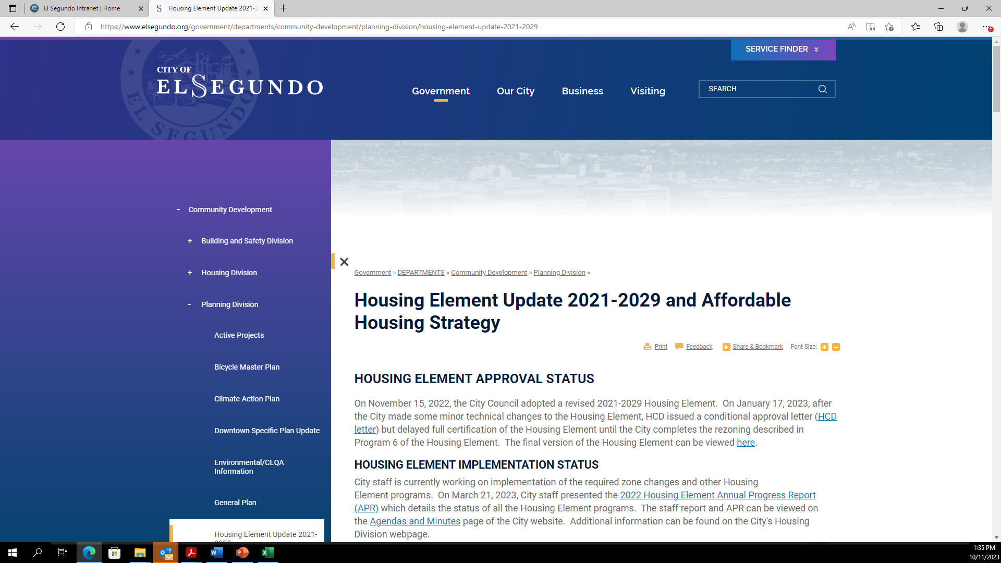
City Website and Resources
www.elsegundo.org/housing-element
Housing Element
Annual Progress Report (APR)
Email Updates
Video Links
Related Documents
Notes:
Two websites

Slide 19
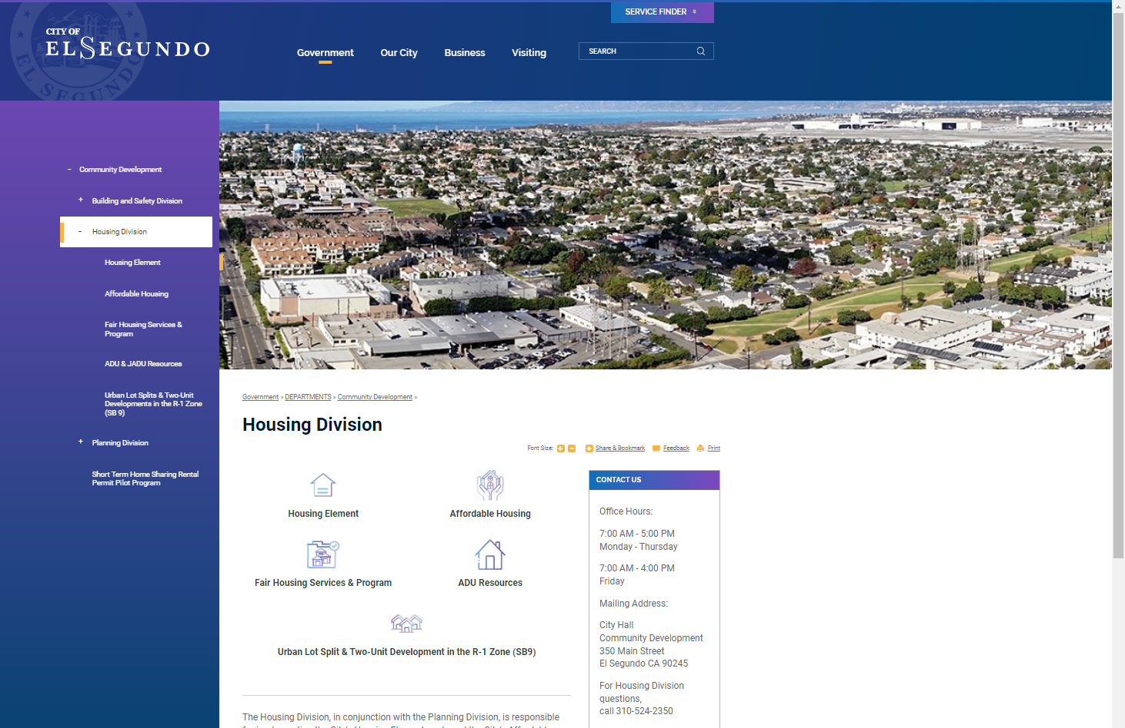
City Website and Resources
Housing Division webpage
Housing Element
Fair Housing Services (LA County)
Affordable Housing Resources
ADU Information and Resources
Notes:
Fair Housing Services, such as the Housing Rights Center, and related links
Affordable projects in the City, available lending programs
ADU – information on regulations, Lending programs (State)
GO OVER THE ADU CALCULATOR

Slide 20
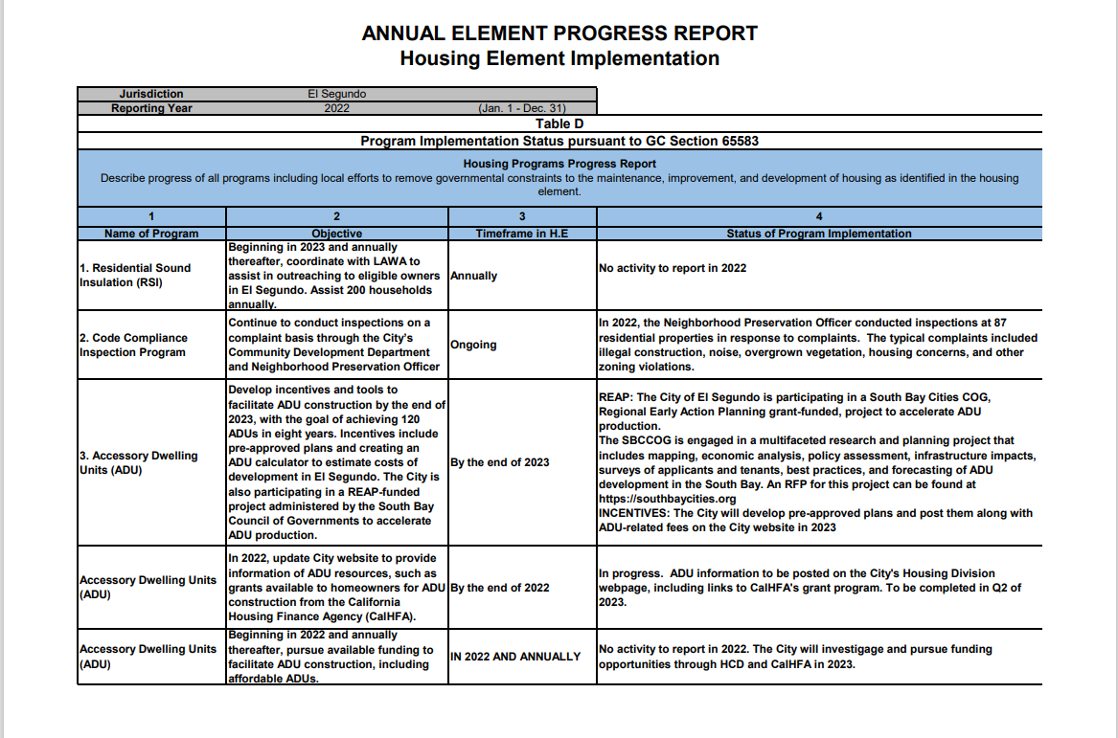
Annual Progress Report
Status on number of units
Market
Affordable
Activity and status on all programs and goals
Notes:
An important part of the Housing Element and the State intention is tracking progress and holding jurisdictions accountable. Thus, the APR requirement (annual, released in March/April, on the website):
45 units total in 2021 and 2022 (no affordable)
22 units 2023.
22 units in 2024 (14 ADUs) full numbers Part of next APR (end of March)
263 (32 affordable) at PCC, but waiting for application
Applications 1) MFR project on Kansas and Grand (323 units, 2) 703 N. PCH (79 units), 3) preliminary project at 639 N. PCH

Slide 21
In the works
ADU permit fee calculator
Pre-approved ADU plan program
Residential Parking Requirements Amendment
General Plan Land Use Element Update
Smoky Hollow Live/Work Amendment

Slide 22
Questions and Comments

Slide 24
Housing Programs
Residential Sound Insulation (RSI)
Code Compliance Inspection Program
Accessory Dwelling Units (ADU)
Inclusionary Housing Ordinance and Affordable Housing Strategy
Urban Lot Split
Provision of Adequate Sites
Monitoring of No Net Loss
Lot Consolidation
El Segundo Municipal Code Amendments
Community Outreach
Fair Housing
Notes:
A quick word about the Affordable Housing Strategy. The City Council adopted the Affordable Housing Strategy on Dec. 14.
- Codify El Segundo live or work preference for affordable housing
Focus areas (Smoky Hollow, West side of PCH, East Imperial, and Downtown
Downtown housings for young professionals
Funding: Local Affordable Housing Trust Fund (provide matching funds for new aff. Housing)
[Entered into contract with RSG, Inc on July 15, 2024]
Kick off meeting in late September
Timeline for 1st year.

